Slide 1
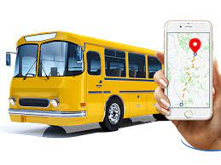
SMART BUS TRACKING GADGET
Group EE

Slide 2

INTRODUCTION
Enhanced Safety
Durability
Optimized Performance
Efficient Fleet Management
Future-Proof Technology

Slide 3
PROJECT OVERVEIW
Define
Define Project Scope
Define
Define GPS Tracker Requirements
Define
Define Software Requirements
Conduct
Conduct Unit Testing
Develop
Develop Maintenance Guidelines

Slide 4
Functional Requirement
Location Tracking
Remote Monitoring
Alerting System
Battery Management
Shock Detection
Communication
Temperature and Humidity Monitoring

Slide 5
TECHNOLOGY WE USED
Real-time Tracking
Remote Monitoring and Control
Battery Management
Shock Resistance
Environment Monitoring

Slide 6
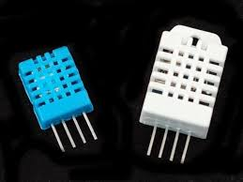
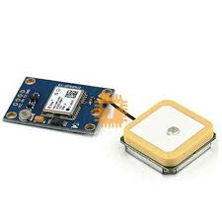
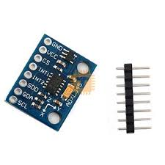
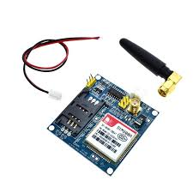

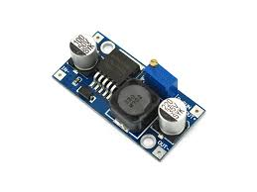
SENSORS

Slide 7

BENIFITS
Improved Safety
Enhanced Efficiency
Cost Savings
Better Passenger Experience
Environmental Impact
Data-driven Insights
Remote Management

Slide 8
FUTURE MAINTENANCE
Continuous Improvement
Scalability
Data Security and Privacy
Reliability and Redundancy
User Training and Support

Slide 9
THANK YOU
GROUP EE
10899521 – Navindu Nimsara Gamage
10899603 – Wedamulla Madinage Thisara Madusanka
10899621- Chathupraba Devindi Munasinghe
10899556- Yaddehi Kishal Sankalpa Jayalath
10899685- Kihaduwage Diduli Wijini Sahasra
10899600- Senanayake Dasili Liyanage Sameepa Pramuditha

